Slide 1
Employee Attrition Analysis

Slide 2
Introduction
Analyzing employee attrition rate involves examining the frequency and patterns of staff departures within an organization. This analysis helps identify underlying causes of turnover, such as job dissatisfaction or management issues. By understanding attrition trends, companies can develop targeted retention strategies and improve overall workforce stability. Effective analysis ultimately enhances organizational performance and reduces the costs associated with high employee turnover.

Slide 3
Problem Statement
XYZ Pvt Ltd which was established a few years back is facing around a 15% attrition rate for a couple of years. And it's majorly affecting the company in many aspects. In order to understand why employees are leaving the company and reduce the attrition rate XYZ Pvt Ltd has approached an HR analytics consultancy for analyzing the data they have. You are playing the HR analyst role in this project and building a dashboard which can help the organization in making data-driven decisions.

Slide 4
Techniques used to solve problem :
1. Data Collection:
Employee Demographics: Age, gender, department, job role, tenure, etc.
Employment History: Hire date, resignation date, promotions, salary changes, etc.
2. Data Preparation:
Clean and Transform Data: Remove duplicates, handle missing values, and format data for analysis. Power Query in Power BI is a useful tool for this.
Combine Data Sources: If your data comes from multiple sources (e.g., HR systems, surveys), merge them into a single dataset.
3. Data Modeling:
Define Relationships: If using multiple tables, establish relationships between them (e.g., linking employee records to department tables).
Create Measures: Develop measures for metrics like average tenure, turnover rate, and attrition by department.

Slide 5
Techniques used to solve problem :
4. Visualization:
Create a Power BI report with relevant visualizations. Here are some useful ones:
Turnover Rate: Line chart showing turnover trends over time.
Attrition by Department: Bar chart displaying attrition rates by department or job role.
Employee Demographics: Pie charts or stacked bar charts to show the breakdown of employees by age, gender, or other demographics.
Tenure Analysis: Histogram or box plot showing the distribution of employee tenure.
Attrition Reasons: If available, a bar chart or word cloud visualizing the reasons for leaving.
Performance vs. Attrition: Scatter plot to analyze if there’s a correlation between performance ratings and attrition.

Slide 6
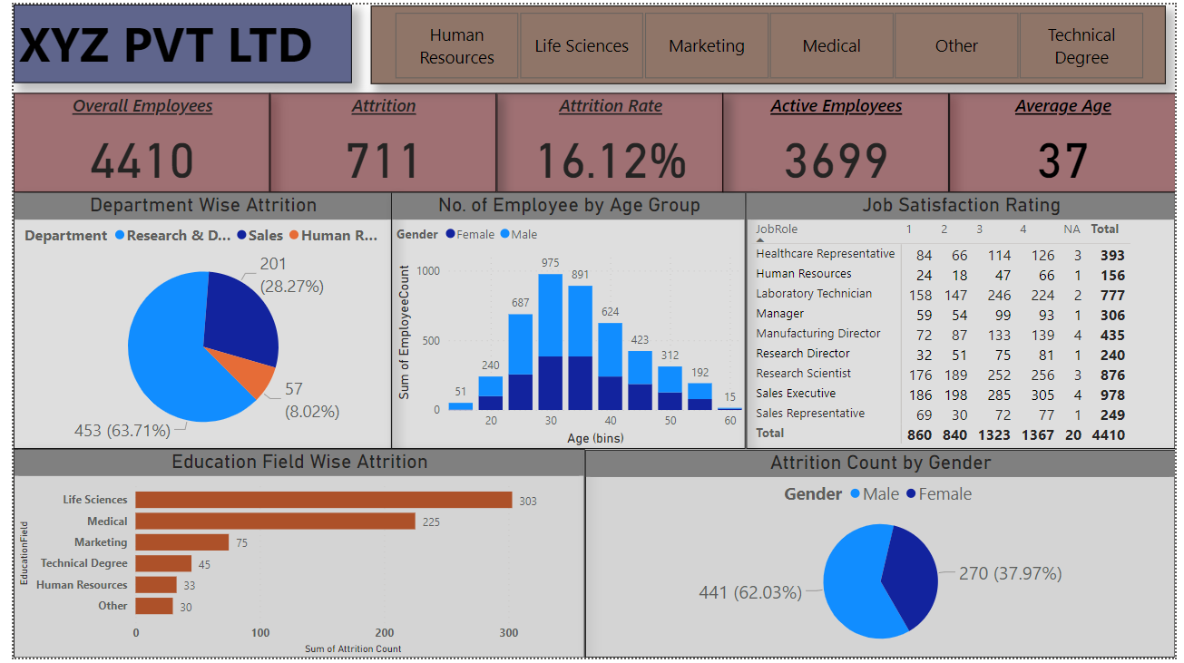
Output of Project :

Slide 7
Thank you

